Slide 1



Flutter
Home
Photo
About Us
Contact
E-commerce
App
Revolutionizing the Online Shopping Experience
Explore Now
Play Video

Slide 2



flutter
Home
Photo
About Us
Contact
The Problem
Online shopping can be overwhelming and impersonal.
01
Limited product discovery
Security concerns during authentication
02
Inconsistent user experiences across platforms.
03

Slide 3



flutter
Home
Photo
About Us
Contact
Our Solution
A modern, user-friendly e-commerce app designed to meet user needs efficiently and securely.
Integrated cart and profile management for convenience.
01
product Categorization
02
Fast and responsive design for a hassle-free experience.
Seamless user authentication and secure data handling.
03
04

Slide 4

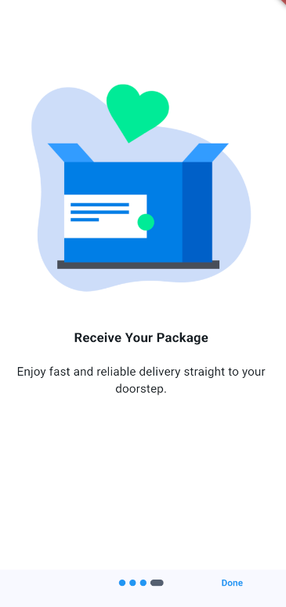
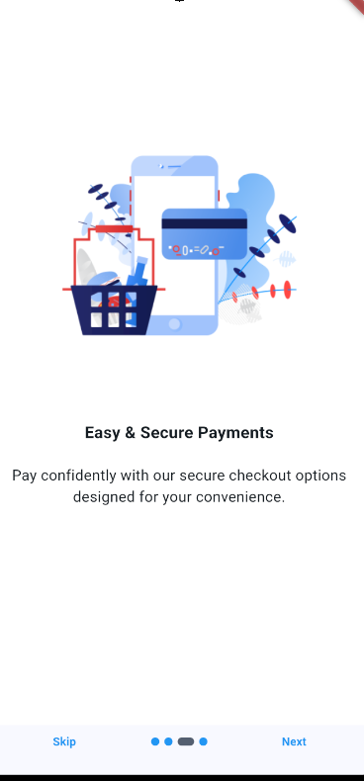
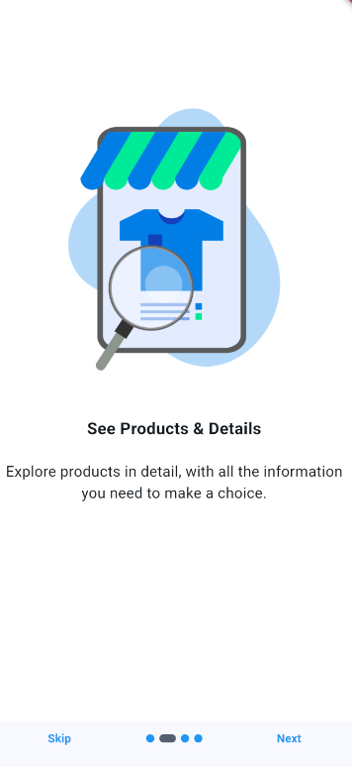
Studio Shodwe
Home
Photo
About Us
Contact
Value Proposition
01
Convenience: Browse, search, and shop anytime, anywhere.
02
Personalization: Tailored product suggestions for every user
03
.
Security: Built with Firebase Authentication and validation.
04
Speed: Powered by efficient APIs for fast response times.

Slide 5
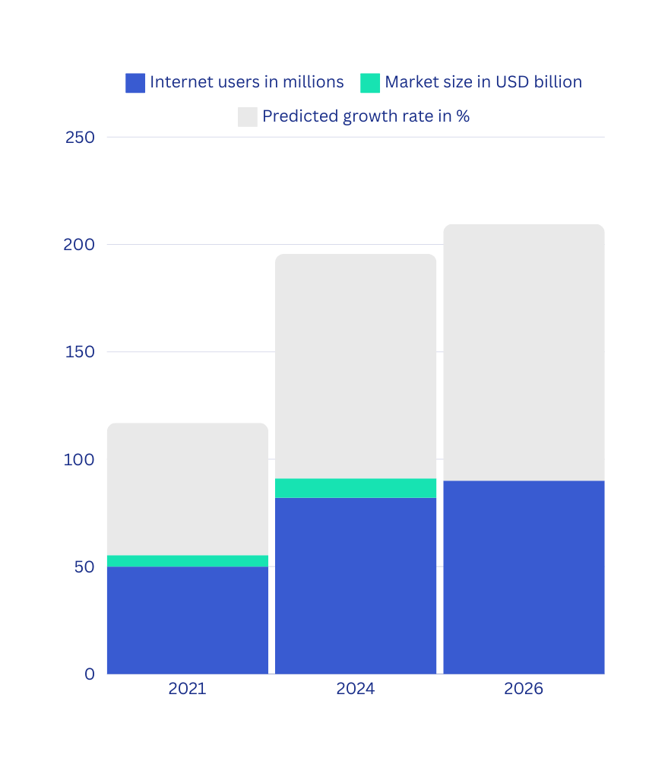

MARKET ANALYSIS
05
MARKET ANALYSIS
Tech-savvy online shoppers aged 18-35.
Individuals looking for personalized shopping experiences.
MARKET SIZE
Global e-commerce sales projected to reach $7.4 trillion by 2025.
GEOGRAPHIC FOCUS
Initially targeting [specific regions] with high e-commerce adoption.

Slide 6
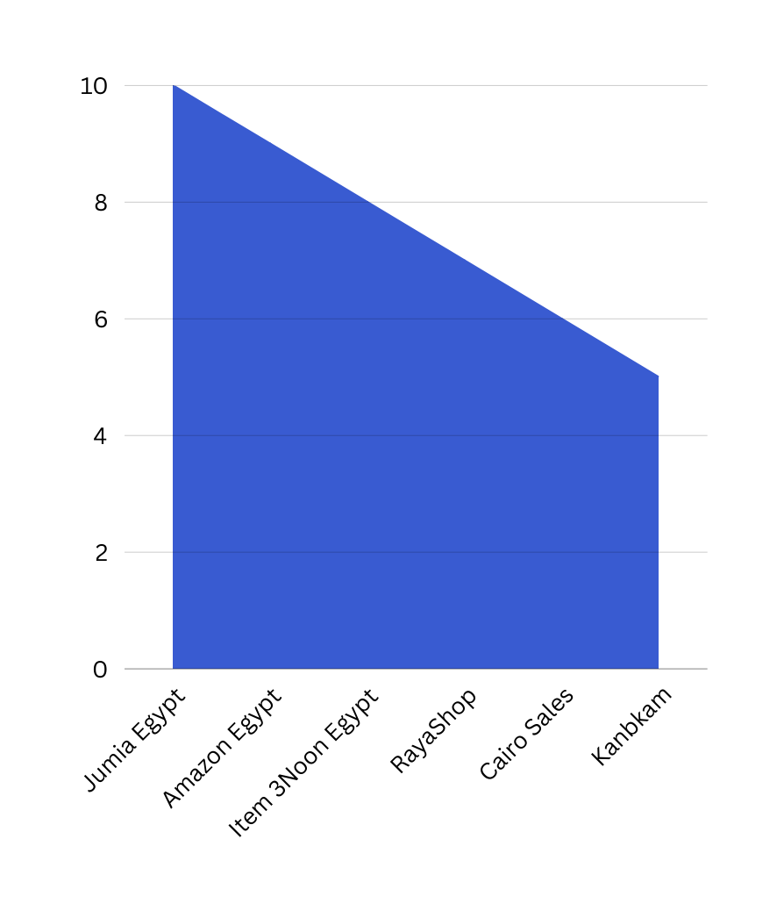
COMPETITIVE ANALYSIS
05
CURRENT PLAYERS
Jumia Egypt
Noon Egypt
Amazon Egypt
Kanbkam
RayaShop
Cairo Sales

Slide 7
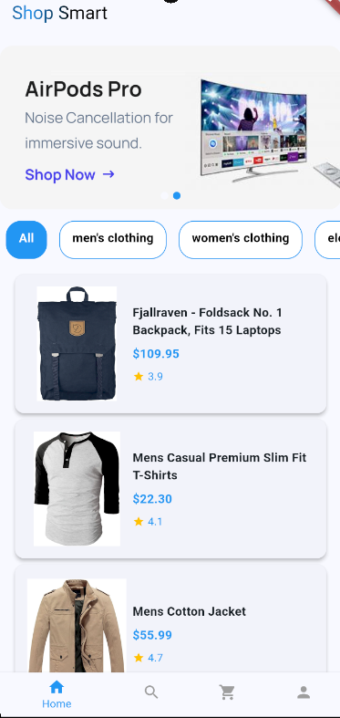
COMPETITIVE ANALYSIS
05
HOW WE STAND OUT:
Modern and minimalist design.
Superior onboarding experience with carousel highlights.
Faster and more secure user authentication.

Slide 8
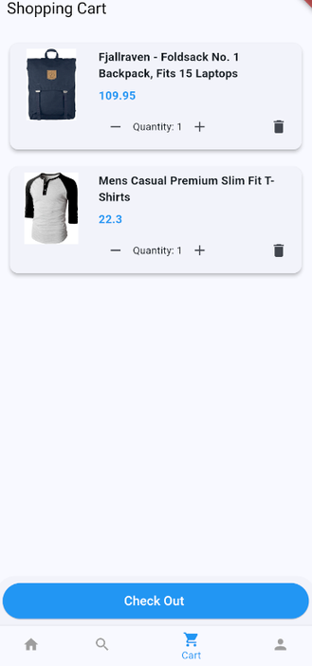
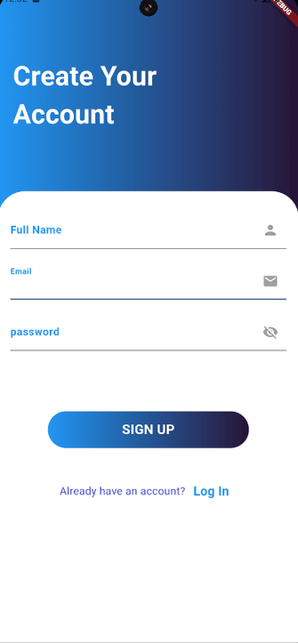
Flutter
Home
Photo
About Us
Contact
Key Features in Action
01
Home Page: Dynamic product display with fast-loading APIs.
Onboarding Screens: Interactive carousels showcasing app benefits.
02
03
Cart Management: Real-time updates for user convenience.
user authentication
02

Slide 9
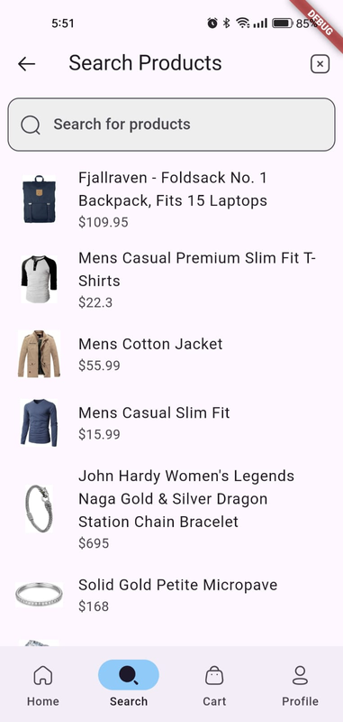
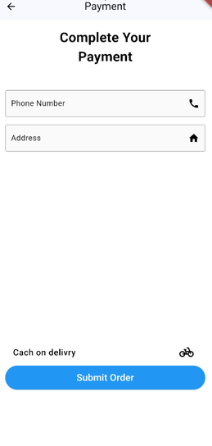
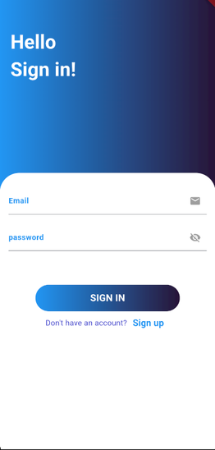
Studio Shodwe
Home
Photo
About Us
Contact
Portfolio Section
Shop easily

Slide 10


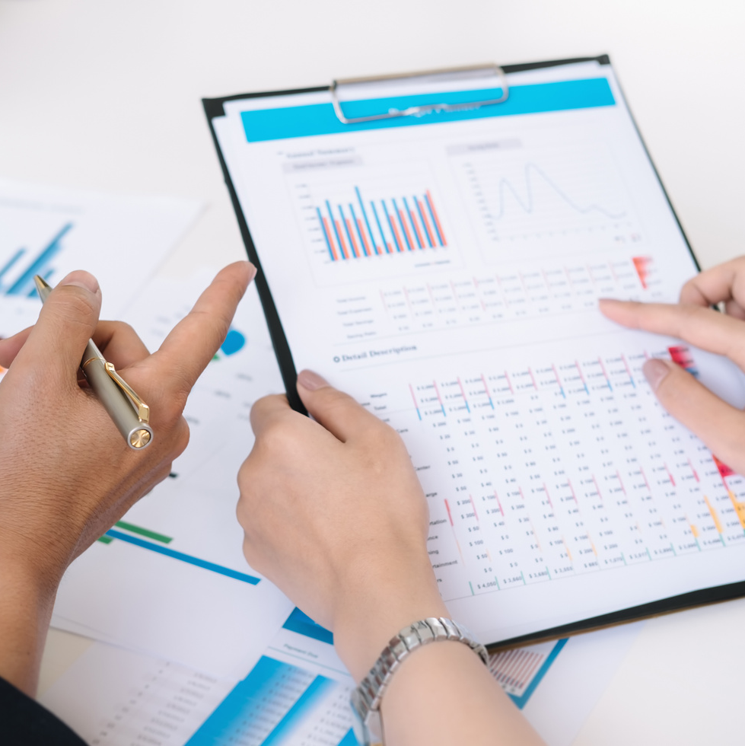

AROWWAI INDUSTRIES
STRATEGY
IN 2025
Digital Advertising:
01
Use of Google Ads and social media platforms like Instagram, Facebook, and TikTok.
Highlighted campaigns on “fast and secure shopping.”
02
Influencer Marketing
Partner with influencers in the tech and lifestyle niches.
03
Referral Program
Encourage users to refer friends with discounts and perks.
About Marketing
SEO Optimization
03
20
22
Blog posts, product reviews, and how-to guides to improve visibility.

Slide 11
AROWWAI INDUSTRIES
MONETIZATION PLAN
IN 2025
UPSELLING OPPORTUNITIES:
REVENUE STREAMS:
Commission-based revenue from merchants.
Subscription plans for premium features (e.g., faster delivery, exclusive deals).
In-app advertising for related products.
Bundle deals and loyalty programs.
20
22

Slide 12
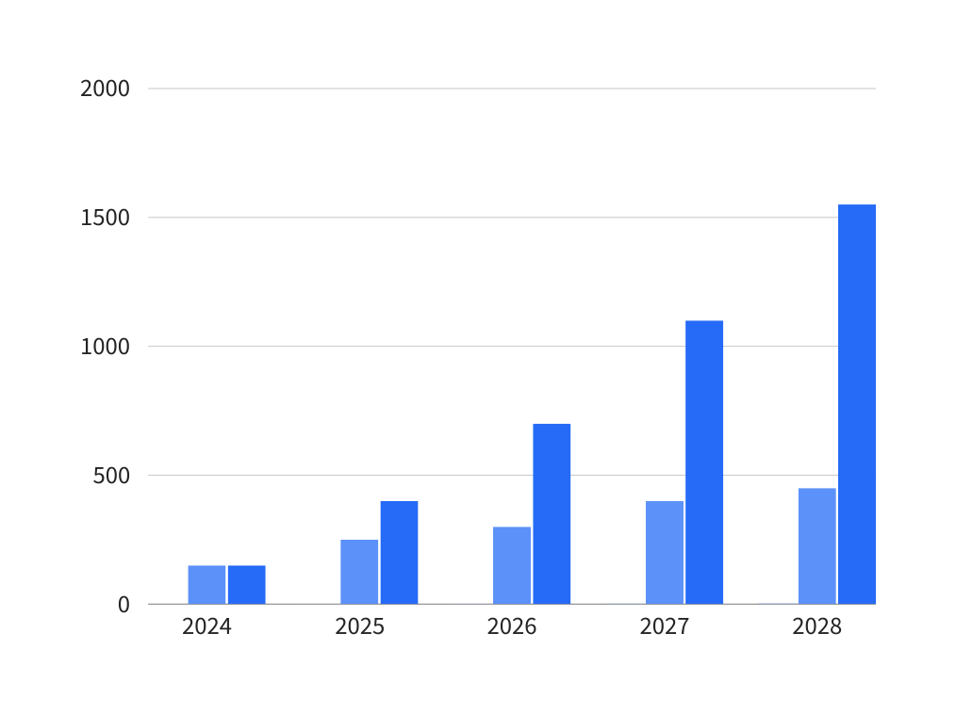
AROWWAI INDUSTRIES
INFOGRAPHIC
SECTION
Future Features:
AI-powered product recommendations based on user behavior.
Integration of payment gateways like PayPal, Stripe.
Multilingual support for global expansion.
Scalability:
Easily adaptable to include new categories, products, and regions.
PREDICTED GROWTH
LEARN MORE
20
25

Slide 13



AROWWAI INDUSTRIES
CALL TO ACTION
For Investors
Join us in transforming the future of online shopping.
CONTACT
Email : hello@reallygreatsite.com
+123-456-7890
For Users
Download now and experience shopping like never before!”
20
22
Download Now

Slide 14




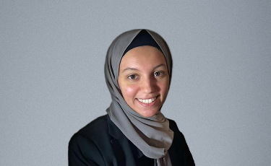
MEET OUR TEAM
Arsany Morcos
Brigitte Schwartz
Mariem Elsaid
Mobile App developer
Accounting Finance
Flutter Developer
20
20
Gaser Youssef
Malak Amgad
Software Engineer
AI Engineer

Slide 15

Empowering every shopper with ease, security, and speed—because your time matters.
20
25

Slide 16
Flutter
Home
Photo
About Us
Contact
Thank You

